Slide 1
Bond
Uva 11354
Time: 8 seconds

Slide 2
Problem Descriptions (1/2)
Once again, James Bond is on his way to saving the world. Bond’s latest mission requires him to travel between several pairs of cities in a certain country.
The country has N cities (numbered by 1, 2, . . . , N), connected by M bidirectional roads.
Bond is going to steal a vehicle, and drive along the roads from city s to city t. The country’s police will be patrolling the roads, looking for Bond, however, not all roads get the same degree of attention from the police.

Slide 3
Problem Descriptions (2/2)
More formally, for each road MI6 has estimated its dangerousness, the higher it is, the more likely Bond is going to be caught while driving on this road.
Dangerousness of a path from s to t is defined as the maximum dangerousness of any road on this path.
Now, it’s your job to help Bond succeed in saving the world by finding the least dangerous paths for his mission.

Slide 4
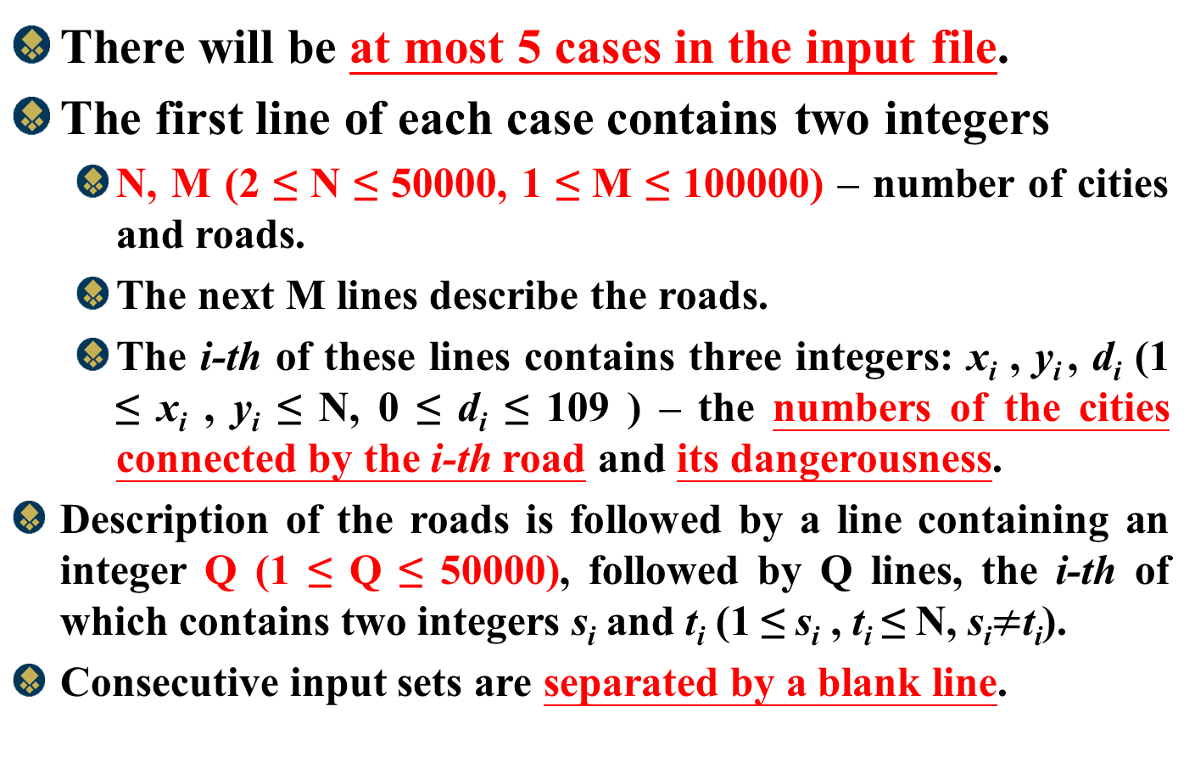
Input
There will be at most 5 cases in the input file.
The first line of each case contains two integers
N, M (2 ≤ N ≤ 50000, 1 ≤ M ≤ 100000) – number of cities and roads.
The next M lines describe the roads.
The i-th of these lines contains three integers: x_{i} , y_{i} , d_{i} (1 ≤ x_{i} , y_{i} ≤ N, 0 ≤ d_{i} ≤ 109 ) – the numbers of the cities connected by the i-th road and its dangerousness.
Description of the roads is followed by a line containing an integer Q (1 ≤ Q ≤ 50000), followed by Q lines, the i-th of which contains two integers s_{i} and t_{i} (1 ≤ s_{i} , t_{i} ≤ N, s_{i}$≠$t_{i}).
Consecutive input sets are separated by a blank line.

Slide 5
Output
For each case, output Q lines, the i-th of which contains the minimum dangerousness of a path between cities s_{i} and t_{i} .
Consecutive output blocks are separated by a blank line. The input file will be such that there will always be at least one valid path.

Slide 6
Sample Input / Output
Number of cities
Input
4 5
1 2 10
1 3 20
1 4 100
2 4 30
3 4 10
2
1 4
4 1
Output
20
20
20
Number of roads
Connect 1 and 2
1
2
3
10
dangerousness
100
30
4
10
20
Number of queries
1
2
3
10
100
30
4
10

Slide 7
Sample Input / Output
Number of cities
Input
4 5
1 2 10
1 3 20
1 4 100
2 4 30
3 4 10
2
1 4
4 1
Output
20
20
20
Number of roads
Connect 1 and 2
1
2
3
10
dangerousness
100
30
4
10
20
Number of queries
1
2
3
10
100
30
4
10

Slide 8
Kruskal’s Algorithm
Answer: Minimum Cost=46
Sort Edges:
2
3
4
5
6
8
9
10
14
15
A
6
4
H
5
B
9
C
14
2
10
G
E
15
D
3
8
F

Slide 9
Kruskal’s Algorithm
Kruskal’s Algorithm( G(V,E) )
{ T← ∅
While |T|<|V|-1 and E≠ ∅
{ ExtraxtMin (v,w) from E
If(v,w)doesn’t cause cycle in T
then add (v,w) to T
else discard (v,w)
}
}

Slide 10
Disjoint-Set Union Problem
Disjoint sets , S_{i} ∩ S_{j} = ∅
Need to support following operations:
MakeSet(x): S={x}
Union(S_{i}, S_{j}): {S_{i} U S_{j}}
FindSet(x): return S, such that x ∈ S

Slide 11
Kruskal’s Algorithm
Kruskal()
{
T = ∅;
for each v ∈ V
MakeSet(v);
sort E by increasing edge weight w
for each (u,v) ∈ E (in sorted order)
if FindSet(u) ≠ FindSet(v)
T = T U {(u,v)};
Union(FindSet(u), FindSet(v));
}

Slide 12
Kruskal’s Algorithm
Kruskal()
{
T = ∅;
for each v ∈ V
MakeSet(v);
sort E by increasing edge weight w
for each (u,v) ∈ E (in sorted order)
if FindSet(u) ≠ FindSet(v)
T = T U {{u,v}};
Union(FindSet(u), FindSet(v));
}
2
19
9
14
17
8
25
5
21
13
1

Slide 13
Kruskal’s Algorithm
Kruskal()
{
T = ∅;
for each v ∈ V
MakeSet(v);
sort E by increasing edge weight w
for each (u,v) ∈ E (in sorted order)
if FindSet(u) ≠ FindSet(v)
T = T U {(u,v)};
Union(FindSet(u), FindSet(v));
}
2
19
9
14
17
8
25
5
21
13
1

Slide 14
Kruskal’s Algorithm
Kruskal()
{
T = ∅;
for each v ∈ V
MakeSet(v);
sort E by increasing edge weight w
for each (u,v) ∈ E (in sorted order)
if FindSet(u) ≠ FindSet(v)
T = T U {(u,v)};
Union(FindSet(u), FindSet(v));
}
2
19
9
14
17
8
25
5
21
13
1

Slide 15
Kruskal’s Algorithm
Kruskal()
{
T = ∅;
for each v ∈ V
MakeSet(v);
sort E by increasing edge weight w
for each (u,v) ∈ E (in sorted order)
if FindSet(u) ≠ FindSet(v)
T = T U {(u,v)};
Union(FindSet(u), FindSet(v));
}
2
19
9
14
17
8
25
5
v
21
13
1
u

Slide 16
Kruskal’s Algorithm
Run the algorithm:
Kruskal()
{
T = ∅;
for each v ∈ V
MakeSet(v);
sort E by increasing edge weight w
for each (u,v) ∈ E (in sorted order)
if FindSet(u) ≠ FindSet(v)
T = T U {(u,v)};
Union(FindSet(u), FindSet(v));
}
2
19
9
14
17
8
25
5
21
13
1

Slide 17
Kruskal’s Algorithm
Run the algorithm:
Kruskal()
{
T = ∅;
for each v ∈ V
MakeSet(v);
sort E by increasing edge weight w
for each (u,v) ∈ E (in sorted order)
if FindSet(u) ≠ FindSet(v)
T = T U {(u,v)};
Union(FindSet(u), FindSet(v));
}
u
2
v
19
9
14
17
8
25
5
21
13
1

Slide 18
Kruskal’s Algorithm
Kruskal()
{
T = ∅;
for each v ∈ V
MakeSet(v);
sort E by increasing edge weight w
for each (u,v) ∈ E (in sorted order)
if FindSet(u) ≠ FindSet(v)
T = T U {(u,v)};
Union(FindSet(u), FindSet(v));
}
2
19
9
14
17
8
25
5
21
13
1

Slide 19
Kruskal’s Algorithm
Kruskal()
{
T = ∅;
for each v ∈ V
MakeSet(v);
sort E by increasing edge weight w
for each (u,v) ∈ E (in sorted order)
if FindSet(u) ≠ FindSet(v)
T = T U {(u,v)};
Union(FindSet(u), FindSet(v));
}
u
2
19
9
14
17
8
25
5
21
13
1
v

Slide 20
Kruskal’s Algorithm
Kruskal()
{
T = ∅;
for each v ∈ V
MakeSet(v);
sort E by increasing edge weight w
for each (u,v) ∈ E (in sorted order)
if FindSet(u) ≠ FindSet(v)
T = T U {(u,v)};
Union(FindSet(u), FindSet(v));
}
2
19
9
14
17
8
25
5
21
13
1

Slide 21
Kruskal’s Algorithm
Kruskal()
{
T = ∅;
for each v ∈ V
MakeSet(v);
sort E by increasing edge weight w
for each (u,v) ∈ E (in sorted order)
if FindSet(u) ≠ FindSet(v)
T = T U {(u,v)};
Union(FindSet(u), FindSet(v));
}
u
2
19
9
14
17
8
25
5
v
21
13
1

Slide 22
Kruskal’s Algorithm
Kruskal()
{
T = ∅;
for each v ∈ V
MakeSet(v);
sort E by increasing edge weight w
for each (u,v) ∈ E (in sorted order)
if FindSet(u) ≠ FindSet(v)
T = T U {(u,v)};
Union(FindSet(u), FindSet(v));
}
2
19
9
14
17
8
25
5
21
13
1

Slide 23
Kruskal’s Algorithm
Kruskal()
{
T = ∅;
for each v ∈ V
MakeSet(v);
sort E by increasing edge weight w
for each (u,v) ∈ E (in sorted order)
if FindSet(u) ≠ FindSet(v)
T = T U {(u,v)};
Union(FindSet(u), FindSet(v));
}
2
19
u
9
v
14
17
8
25
5
21
13
1

Slide 24
Kruskal’s Algorithm
Kruskal()
{
T = ∅;
for each v ∈ V
MakeSet(v);
sort E by increasing edge weight w
for each (u,v) ∈ E (in sorted order)
if FindSet(u) ≠ FindSet(v)
T = T U {(u,v)};
Union(FindSet(u), FindSet(v));
}
2
19
9
14
17
8
25
5
u
v
21
13
1

Slide 25
Kruskal’s Algorithm
Kruskal()
{
T = ∅;
for each v ∈ V
MakeSet(v);
sort E by increasing edge weight w
for each (u,v) ∈ E (in sorted order)
if FindSet(u) ≠ FindSet(v)
T = T U {(u,v)};
Union(FindSet(u), FindSet(v));
}
2
19
9
14
17
8
25
5
21
13
1

Slide 26
Kruskal’s Algorithm
Run the algorithm:
Kruskal()
{
T = ∅;
for each v ∈ V
MakeSet(v);
sort E by increasing edge weight w
for each (u,v) ∈ E (in sorted order)
if FindSet(u) ≠ FindSet(v)
T = T U {(u,v)};
Union(FindSet(u), FindSet(v));
}
2
19
u
9
14
17
8
25
v
5
21
13
1

Slide 27
Kruskal’s Algorithm
Kruskal()
{
T = ∅;
for each v ∈ V
MakeSet(v);
sort E by increasing edge weight w
for each (u,v) ∈ E (in sorted order)
if FindSet(u) ≠ FindSet(v)
T = T U {(u,v)};
Union(FindSet(u), FindSet(v));
}
2
19
9
14
17
8
25
5
21
13
1

Slide 28
Kruskal’s Algorithm
Kruskal()
{
T = ∅;
for each v ∈ V
MakeSet(v);
sort E by increasing edge weight w
for each (u,v) ∈ E (in sorted order)
if FindSet(u) ≠ FindSet(v)
T = T U {{u,v}};
Union(FindSet(u), FindSet(v));
}
2
19
v
9
14
17
8
25
5
u
21
13
1

Slide 29
Kruskal’s Algorithm
Kruskal()
{
T = ∅;
for each v ∈ V
MakeSet(v);
sort E by increasing edge weight w
for each (u,v) ∈ E (in sorted order)
if FindSet(u) ≠ FindSet(v)
T = T U {{u,v}};
Union(FindSet(u), FindSet(v));
}
2
u
19
v
9
14
17
8
25
5
21
13
1

Slide 30
Kruskal’s Algorithm
Kruskal()
{
T = ∅;
for each v ∈ V
MakeSet(v);
sort E by increasing edge weight w
for each (u,v) ∈ E (in sorted order)
if FindSet(u) ≠ FindSet(v)
T = T U {{u,v}};
Union(FindSet(u), FindSet(v));
}
2
19
9
14
17
8
25
5
u
v
21
13
1

Slide 31
Kruskal’s Algorithm
Kruskal()
{
T = ∅;
for each v ∈ V
MakeSet(v);
sort E by increasing edge weight w
for each (u,v) ∈ E (in sorted order)
if FindSet(u) ≠ FindSet(v)
T = T U {{u,v}};
Union(FindSet(u), FindSet(v));
}
2
19
u
9
14
17
8
25
5
v
21
13
1

Slide 32
Kruskal’s Algorithm
Kruskal()
{
T = ∅;
for each v ∈ V
MakeSet(v);
sort E by increasing edge weight w
for each (u,v) ∈ E (in sorted order)
if FindSet(u) ≠ FindSet(v)
T = T U {{u,v}};
Union(FindSet(u), FindSet(v));
}
2
19
9
14
17
8
25
5
21
13
1

Slide 33
Set Representation
S1={0, 6, 7, 8}, S2={1, 4, 9}, S3={2, 3, 5}
Two operations considered here
Disjoint set union :
ex: S₁ ∪ S₂={0,6,7,8,1,4,9}
Find(i) : Find the set containing the element i. ex: Find(3) ∈ S₃, Find(8) ∈ S₁
0
4
2
6
7
8
1
9
3
5
S_{i} ∩ S_{j} = φ

Slide 34
Set Representation
Union and Find Operations
Make one of trees a subtree of the other
4
0
0
1
9
6
7
8
4
9
6
7
8
1
Possible representation for S1 union S2
S1={0, 6, 7, 8}, S2={1, 4, 9}

Slide 35
Array Set Representation
4
1
9
S1={0, 6, 7, 8}, S2={1, 4, 9}, S3={2, 3, 5}
0
i
[0]
[1]
[2]
[3]
[4]
[5]
[6]
[7]
[8]
[9]
6
7
8
parent
-
4
4
-
3
2
-
3
2
0
0
0
4
2
5
int find1(int i) {
for(; parent[i] >= 0; i = parent[i]);
return i;
}
void union1(int i, int j) {
parent[i] = j;
}
3

Slide 36
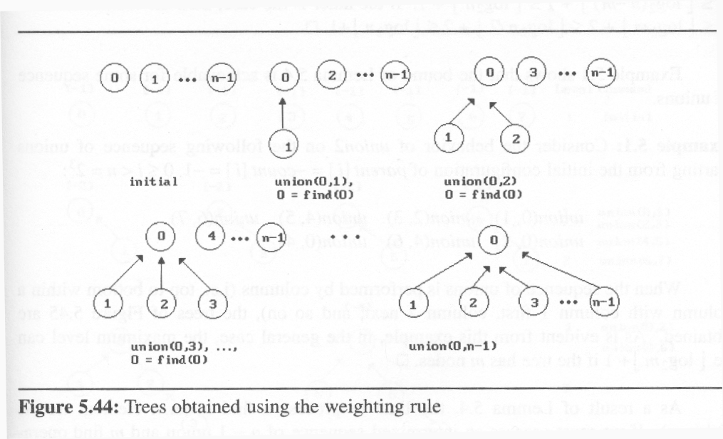
Set Representation
weighting rule for union(i,j):
If (no. of nodes in i) < (no. of nodes in j) then i (少) → j (多)
2
1
3
1

Slide 37
Modified Union Operation
void union2(int i, int j)
{
int temp = parent[i] + parent[j];
if (parent[i] > parent[j]) {
parent[i] = j; /*make j the new root*/
parent[j] = temp;
}
else {
parent[j] = i;/* make i the new root*/
parent[i] = temp;
}
}

Slide 38
Modified Find(i) Operation
int find2(int i)
{
int root, trail, lead;
for(root=i;parent[root]>=0;root=parent[root]);
for (trail=i; trail!=root; trail=lead)
{
lead = parent[trail];
parent[trail]= root;
}
return root;
}
parent[root]==-8
root==0
0
root==4
1
2
4
root==6
3
5
6
If j is a node on the path from
i to its root then make j a child
of the root
lead==6
root==7
i==7
trail==7
7

Slide 39
Modified Find(i) Operation
int find2(int i)
{
int root, trail, lead;
for(root=i;parent[root]>=0;root=parent[root]);
for (trail=i; trail!=root; trail=lead)
{
lead = parent[trail];
parent[trail]= root;
}
return root;
}
root==0
0
1
2
4
lead==4
trail==6
3
5
6
If j is a node on the path from
i to its root then make j a child
of the root
7

Slide 40
Modified Find(i) Operation
int find2(int i)
{
int root, trail, lead;
for(root=i;parent[root]>=0;root=parent[root]);
for (trail=i; trail!=root; trail=lead)
{
lead = parent[trail];
parent[trail]= root;
}
return root;
}
lead==0
root==0
0
trail==4
1
2
4
3
5
6
If j is a node on the path from
i to its root then make j a child
of the root
7

Slide 41
Edge Data Structure
typedef struct _edge
{
int from, to, weight;
_edge(){};
_edge(int u, int v, int w):from(u), to(v), weight(w){};
} Edge;

Slide 42
Graph Data Structure
typedef pair<int,int> ii;
class Graph
{
private:
int num_vertex;
int AdjMatrix[MAX_CITY][MAX_CITY]={{0}};
vector<ii> MST[MAX_CITY];
int vset[MAX_CITY]={0};
public:
Graph(int n):num_vertex(n){};
void AddEdge(int from, int to, int weight);
void EdgeSort(vector<Edge> &edge_vec);
friend int FindParent(int *vset, int i);
friend void SetUnion(int *vset, int x, int y);
void Kruskal();
int DFSUtil(int s, int d, bool visited[],bool* found);
int DFS(int s, int d);
};

Slide 43
Disjoint Set-Union
void SetUnion(int *vset, int a, int b)
{
int a_root,b_root;
a_root=FindRoot(vset, a);
b_root=FindRoot(vset, b);
if (vset[a_root] <= vset[b_root])
{
vset[a_root] += vset[b_root];
vset[b_root] = a_root;
}
else
{
vset[b_root] += vset[a_root];
vset[a_root] = b_root;
}
}

Slide 44
Disjoint Set-Find Root
int FindRoot(int *vset, int i)
{
int root;
for (root = i; vset[root] >= 0; root = vset[root]);
while (i != root)
{
int parent = vset[i];
vset[i] = root;
i = parent;
}
return root;
}

Slide 45
EdgeSort
void Graph::AddEdge(int from, int to, int weight)
{
AdjMatrix[from][to] = weight;
AdjMatrix[to][from] = weight;
}
bool WComp(Edge e1, Edge e2)
{
return (e1.weight < e2.weight);
}
void Graph::EdgeSort(vector<Edge> &edge_vec)
{
for (int i = 1; i<=num_vertex; i++)
{
for (int j = i+1; j<=num_vertex; j++)
{
if (AdjMatrix[i][j] != 0)
{
edge_vec.push_back(Edge(i,j,AdjMatrix[i][j]));
}
}
}
qsort(edge_vec.begin(), edge_vec.end(), WComp);
}

Slide 46
Kruskal Algorithm
void Graph::Kruskal()
{
int edge_count = 0;
for (int i = 1; i <= num_vertex; i++)
vset[i] = -1;
vector <Edge> SortedEdge;
EdgeSort(SortedEdge);
for (int i = 0; i < SortedEdge.size(); i++)
{
if (FindRoot(vset, SortedEdge[i].from) != FindRoot(vset, SortedEdge[i].to))
{
MST[SortedEdge[i].from].push_back(make_pair(SortedEdge[i].to,SortedEdge[i].weight));
MST[SortedEdge[i].to].push_back(make_pair(SortedEdge[i].from,SortedEdge[i].weight));
SetUnion(vset, SortedEdge[i].from, SortedEdge[i].to);
edge_count++;
if (edge_count==(num_vertex-1))
break;
}
}
}

Slide 47
DFS
int Graph::DFS(int s, int d)
{
bool *visited = new bool[MAX_CITY];
bool found=false;
int weight=0;
for (int i = 0; i < MAX_CITY; i++)
visited[i] = false;
return(DFSUtil(s, d, visited,&found));
}

Slide 48
DFS
int Graph::DFSUtil(int s, int d, bool visited[], bool* found)
{
visited[s] = true;
int m=0;
vector<ii>::iterator i;
for (i = MST[s].begin(); i != MST[s].end(); i++)
{
if (!visited[(*i).first] && (*i).first==d)
{
*found=true;
return((*i).second);
}
else if (!visited[(*i).first])
{
m=DFSUtil((*i).first, d, visited, found);
if (*found)
return ( m >(*i).second ? m:(*i).second) ;
}
}
if (!(*found))
return(0);
}

